Slide 1
P56 - Benchmark Commercial AI Product for Medical Imaging Services Provider
Project Name: Benchmarking Commercial AI-ISYS3888
Project Period: 2022/8 - 2022/12
Sponsor(s) Client: Professor Simon Poon
Organisation: USYD
Project Supervisor: Yaoqi Huang
Class Time: Tuesdays 3:00pm-5:00pm
Kiran Papalkar 490411205 kpap8603
Bronte Lee 490420056 blee6992
Benjamin Men 500401903 jmen0495
Zheyuan Zhang 500023392 zzha3548
Cailin Feldman 480439062 cfel2589
Andersen Liu 480022439 bliu3122(Other group name: SOFT3888_TU12_01(RE), project name: P08 - WeBike)
Zichen Li 500174041 zili4471 (Other group name: SOFT3888_W16_02(REMOTE), project name: P25 - Travel plan and diary application)

Slide 2
Introduction of Project and Stakeholders
Project Goal
The project’s aim is to identify the best computer-aided detection (CAD) commercial products that will be able to diagnose TB.
Stakeholders
Medical health care professional
Regulators, Program directors
Board of health service companies
Users of the technology who are screened
Scope
Diagnostic test accuracy of qXR against its competitors
Analysis identify factors affecting user acceptance

Slide 3
System Specification
Functional:
Prove that AI is technically viable
Benchmark qXR against other AI products
Identify AI accuracy
Identify AI efficiency
Non-Functional:
Report covers all requirements
Meets client’s time demands
Report uses reliable research
Technical Constraints:
Availability of research papers
Validity of research papers
Usability of dashboard
User Story
As a radiologist, I want to ensure that qXR is the most appropriate AI tool for my needs so that I can treat my patients accordingly.
Acceptance Criteria: qXR successfully benchmarked against competitive AI tools that are certified

Slide 4
Quality Of Work
Testing Plan
Article Quality
Systematic Review Quality
Meta-Analysis Quality
Evaluation Quality
Report Quality
Presentation Quality
Limitations
Use of qualitative tests

Slide 5
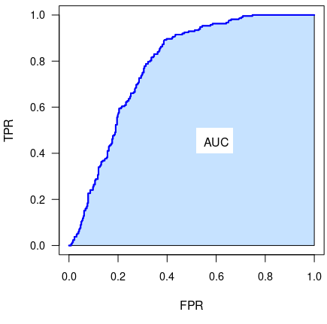
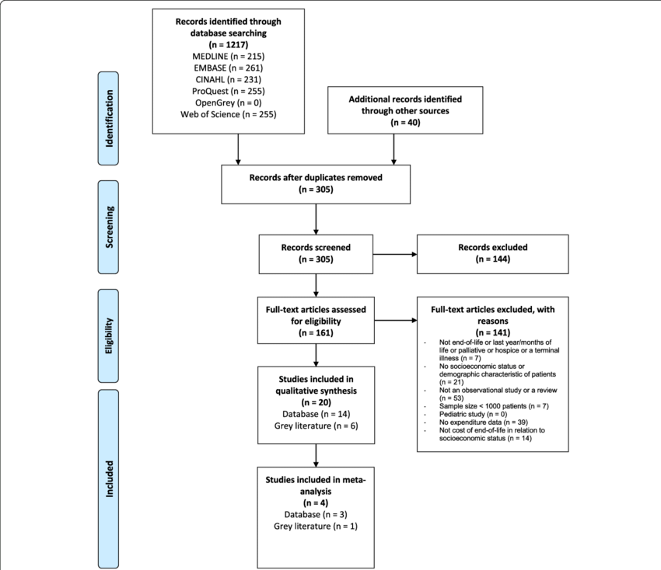
Discipline

Slide 6
Plan for Remaining Requirements/User Stories Potential Project Risks
Finalize the systematic review for our TB products
Work through the user stories left
Start to prepare meta analysis for the project
Prepare the client deployment and doing a demo for our client
Project Risks:
No enough articles
Lack of data

Slide 7
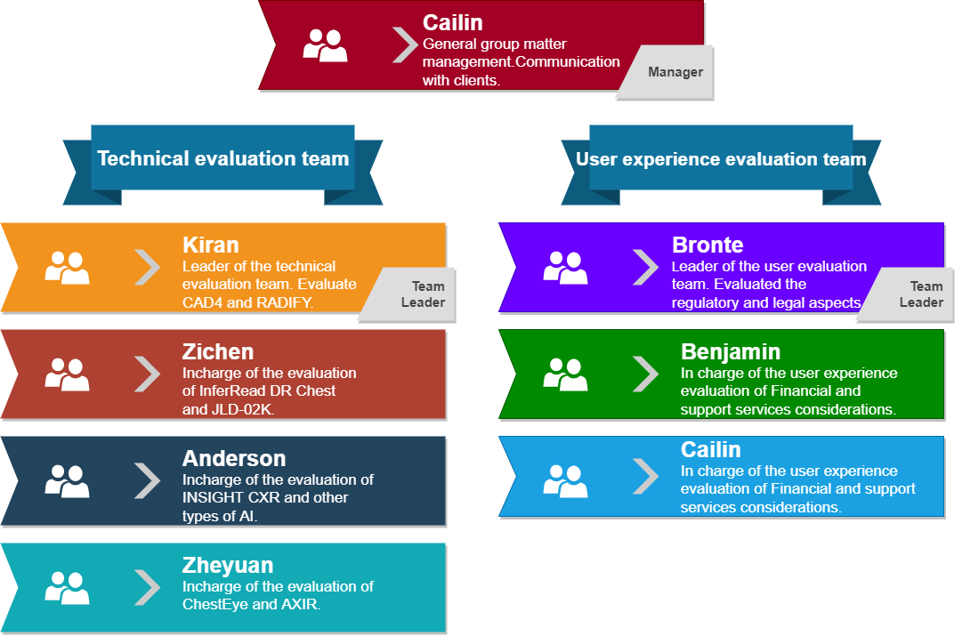
Group Processes

Slide 8
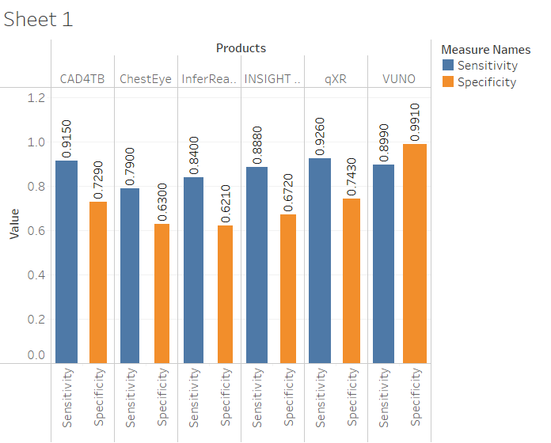
Demonstration

